Slide 1

EDEXCEL GCSE BUSINESS · PAPER 1
Business stakeholders
Understanding external influences on business
Lesson 1 of 5
openrevise.com

Slide 2

EDEXCEL GCSE BUSINESS · PAPER 1
Last Chapter
Answer from memory before the answers appear.
What is limited liability?
1
Name the four location factors.
2
Name the four Ps.
3
Give two reasons for writing a business plan.
4
Understanding external influences on business
openrevise.com
Lesson 1 of 5

Slide 3
EDEXCEL GCSE BUSINESS · PAPER 1
Last Chapter - Answers
What is limited liability?
The owners can only lose the money they invested in the business.
1
Name the four location factors.
Proximity to the market, labour, materials and competitors.
2
Name the four Ps.
Product, price, promotion and place.
3
Give two reasons for writing a business plan.
To minimise risk and to obtain finance.
4
Understanding external influences on business
openrevise.com
Lesson 1 of 5

Slide 4

EDEXCEL GCSE BUSINESS · PAPER 1
Learning Objectives
Explain who a business's stakeholders are.
1
Explain the different objectives of each stakeholder group.
2
Explain how stakeholders are affected by, and can affect, business activity.
3
Explain why stakeholders' objectives can conflict.
4
Understanding external influences on business
openrevise.com
Lesson 1 of 5

Slide 5

EDEXCEL GCSE BUSINESS · PAPER 1
What Is a Stakeholder?
A stakeholder is any person or group with an interest in a business, because they affect it or are affected by it.
Not just the owners
Customers, staff, suppliers, neighbours and the government all have a "stake" in what the business does.
Internal stakeholders
People inside the business: the owners, managers and employees.
External stakeholders
People outside the business: customers, suppliers, the local community, pressure groups and the government.
Why they matter
A small business needs the support of its stakeholders - without customers, staff and suppliers it cannot operate at all.
Understanding external influences on business
openrevise.com
Lesson 1 of 5

Slide 6

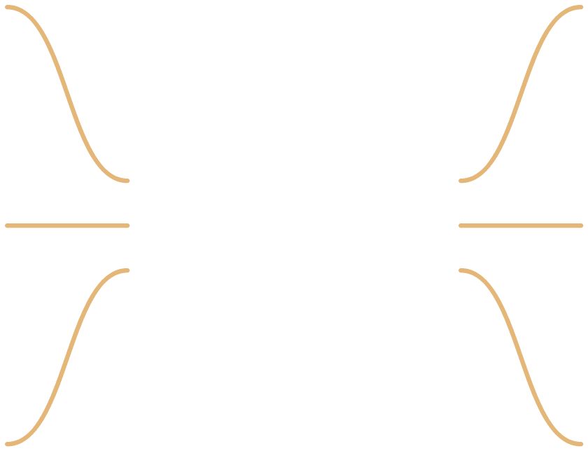
EDEXCEL GCSE BUSINESS · PAPER 1
A small business's stakeholders
Owners (shareholders)
▸ profit
▸ the business surviving and growing
▸ the value of their investment
Customers
▸ good quality
▸ low prices
▸ good service and choice
Employees
▸ fair pay
▸ job security
▸ good working conditions
A small business's stakeholders
Suppliers
▸ regular orders
▸ being paid on time
▸ a long relationship
Managers
▸ a good salary
▸ responsibility
▸ the business succeeding
Local community
▸ jobs
▸ little noise, litter or traffic
▸ support for local causes
Understanding external influences on business
openrevise.com
Lesson 1 of 5

Slide 7
EDEXCEL GCSE BUSINESS · PAPER 1
(cont.)
Pressure groups
▸ the business changing how it behaves on the issue they campaign about
A small business's stakeholders
The government
▸ taxes paid
▸ laws followed
▸ jobs created
Understanding external influences on business
openrevise.com
Lesson 1 of 5

Slide 8


EDEXCEL GCSE BUSINESS · PAPER 1
The People Inside the Business
In a small business the owner and employees work side by side every day. They both want the business to succeed - but the owner wants profit, and the employees want good pay, and every pound spent on one is a pound less for the other.
Owners and employees: internal stakeholders who want different things from the same business.
Understanding external influences on business
openrevise.com
Lesson 1 of 5

Slide 9

EDEXCEL GCSE BUSINESS · PAPER 1
PART ONE
Each Stakeholder's Objectives
What each group wants from the business.
openrevise.com

Slide 10

EDEXCEL GCSE BUSINESS · PAPER 1
Stakeholders and Their Objectives
Stakeholder
Who they are
What they want
Owners (shareholders)
The people who own the business
Profit, survival and growth
Employees
People who work for the business
Good pay, job security, safe conditions
Managers
Employees who run parts of the business
Good salary, responsibility, success
Customers
People who buy the products
Quality, low prices, good service
Suppliers
Businesses that sell materials or stock to it
Regular orders and prompt payment
Local community
People living near the business
Jobs, little disruption, local support
Pressure groups
Groups campaigning on an issue
The business changing its behaviour
The government
National and local government
Taxes, jobs, following the law
Understanding external influences on business
openrevise.com
Lesson 1 of 5

Slide 11
EDEXCEL GCSE BUSINESS · PAPER 1
PART TWO
Stakeholders and the Business
The influence runs both ways.
openrevise.com

Slide 12

EDEXCEL GCSE BUSINESS · PAPER 1
A Two-Way Relationship
HOW BUSINESS ACTIVITY AFFECTS STAKEHOLDERS
HOW STAKEHOLDERS AFFECT THE BUSINESS
• A new café creates jobs for local people.
• Raising prices costs customers more.
• Paying suppliers late causes them cash-flow problems.
• Late-night opening may disturb neighbours.
• Profits pay the owner and taxes pay for public services.
• Customers decide whether to buy - they decide sales.
• Employees' skill and effort decide the quality of service.
• Suppliers can refuse trade credit or raise prices.
• The local council can refuse planning permission.
• Pressure groups can organise protests and bad publicity.
Understanding external influences on business
openrevise.com
Lesson 1 of 5

Slide 13
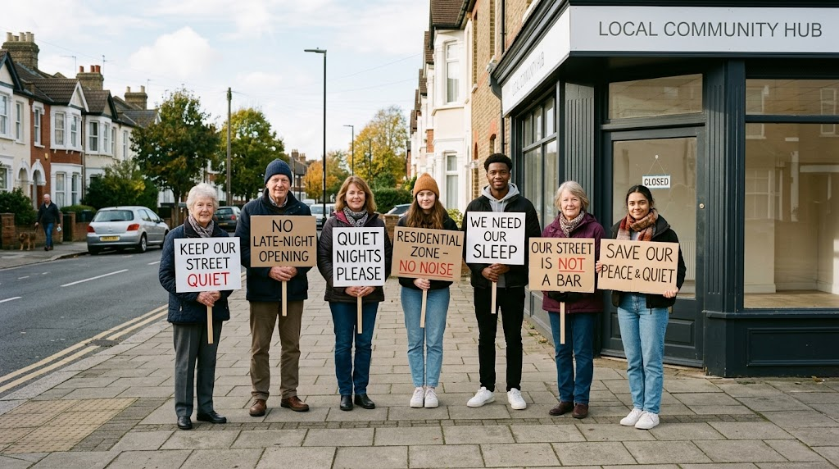
EDEXCEL GCSE BUSINESS · PAPER 1
When the Community Pushes Back
Even a small business can find itself in conflict with its neighbours. Residents worried about noise, litter or traffic can object to planning applications, complain to the council or campaign on social media - and a business that ignores them risks losing both its permission and its reputation.
The local community and pressure groups can change a business's plans.
Understanding external influences on business
openrevise.com
Lesson 1 of 5

Slide 14

EDEXCEL GCSE BUSINESS · PAPER 1
Pressure Groups
A pressure group is an organised group that tries to change what businesses or the government do.
What they want
Change on one issue, such as animal welfare, pollution, plastic waste or protecting a local area.
How they act
Campaigns on social media, protests, petitions, boycotts and contacting the local council or newspapers.
Impact on a small business
Bad publicity can put customers off, so the business may change its plans.
Local groups
Many pressure groups are small and local, formed to fight one decision - such as a new takeaway on a quiet street.
Understanding external influences on business
openrevise.com
Lesson 1 of 5

Slide 15
EDEXCEL GCSE BUSINESS · PAPER 1
PART THREE
When Stakeholders Disagree
What is good for one group can be bad for another.
openrevise.com

Slide 16
EDEXCEL GCSE BUSINESS · PAPER 1
Conflicts Between Stakeholders
Stakeholders
One wants...
The other wants...
Owners and employees
Lower wage costs to raise profit
Higher pay
Owners and customers
Higher prices to raise profit
Lower prices
Customers and local community
Late opening for convenience
Quiet evenings and no litter
Owners and suppliers
Lower prices and longer to pay
Higher prices and prompt payment
Owners and pressure groups
The cheapest packaging
Plastic-free packaging, which costs more
Understanding external influences on business
openrevise.com
Lesson 1 of 5

Slide 17

EDEXCEL GCSE BUSINESS · PAPER 1
Dealing With Conflict
A business cannot please everyone, so it has to make choices.
Prioritise
Most small businesses put customers and owners first, because without sales and profit the business cannot survive.
Compromise
A café might open late on weekends only, to keep customers happy without annoying neighbours every night.
Communicate
Explaining decisions to staff, customers and neighbours can reduce complaints.
Long term
Treating employees, suppliers and the community well often pays off in loyalty and reputation.
Understanding external influences on business
openrevise.com
Lesson 1 of 5

Slide 18

EDEXCEL GCSE BUSINESS · PAPER 1
Key Terms
Stakeholder
Any person or group with an interest in a business, who affects it or is affected by it.
Internal stakeholder
A stakeholder inside the business: owners, managers and employees.
External stakeholder
A stakeholder outside the business, such as customers, suppliers and the community.
Shareholder
An owner of part of a company.
Pressure group
An organised group that tries to change the behaviour of businesses or the government.
Local community
The people who live and work near a business.
Understanding external influences on business
openrevise.com
Lesson 1 of 5

Slide 19

EDEXCEL GCSE BUSINESS · PAPER 1
YOUR TASK
12 minutes
The New Takeaway
A new pizza takeaway plans to open until 2am on a street of houses near a town centre. Choose four stakeholders. For each one, say whether they will support or oppose the plan and why. Then identify the biggest conflict and suggest a compromise.
1
Choose four stakeholders.
2
Support or oppose? Explain why.
3
Name the biggest conflict.
Suggest a compromise.
4
WHAT A GOOD ANSWER SHOWS
Four stakeholders with clear objectives linked to the plan, one conflict explained, and a realistic compromise such as earlier closing on weeknights.
Understanding external influences on business
openrevise.com
Lesson 1 of 5

Slide 20

EDEXCEL GCSE BUSINESS · PAPER 1
Can I...?
Explain what a stakeholder is.
Explain how stakeholders affect a business.
Name the eight stakeholder groups.
Explain what a pressure group does.
Explain the objectives of each group.
Explain a conflict between two stakeholders.
Explain how a business affects its stakeholders.
Suggest how a business could deal with a conflict.
Understanding external influences on business
openrevise.com
Lesson 1 of 5

Slide 21
EDEXCEL GCSE BUSINESS · PAPER 1
Summary & Exam Focus
Stakeholders are anyone affected by, or who affects, a business.
Owners, employees, managers, customers, suppliers, the local community, pressure groups and the government all have different objectives.
Business activity affects stakeholders, and stakeholders affect the business.
Stakeholders' objectives often conflict, so a business has to prioritise or compromise.
EXAM FOCUS
Explain one possible conflict between the owners and the employees of a small business. (3 marks)
Name both stakeholders and what each one wants, then explain why the business cannot fully give both what they want at the same time.
openrevise.com

