Slide 1

EDEXCEL GCSE BUSINESS · PAPER 1
Technology and business
Understanding external influences on business
Lesson 2 of 5
openrevise.com

Slide 2

EDEXCEL GCSE BUSINESS · PAPER 1
Last Lesson
Answer from memory before the answers appear.
What is a stakeholder?
1
Name two external stakeholders.
2
What do employees usually want?
3
Give one example of a stakeholder conflict.
4
Understanding external influences on business
openrevise.com
Lesson 2 of 5

Slide 3
EDEXCEL GCSE BUSINESS · PAPER 1
Last Lesson - Answers
What is a stakeholder?
Anyone who affects, or is affected by, a business.
1
Name two external stakeholders.
Any two of: customers, suppliers, the local community, pressure groups, the government.
2
What do employees usually want?
Fair pay, job security and good working conditions.
3
Give one example of a stakeholder conflict.
Owners want profit; employees want higher pay - or owners want higher prices; customers want lower prices.
4
Understanding external influences on business
openrevise.com
Lesson 2 of 5

Slide 4

EDEXCEL GCSE BUSINESS · PAPER 1
Learning Objectives
Explain the types of technology used by small businesses: e-commerce, social media, digital communication and payment systems.
1
Explain how technology affects a business's sales.
2
Explain how technology affects a business's costs.
3
Explain how technology affects the marketing mix.
4
Understanding external influences on business
openrevise.com
Lesson 2 of 5

Slide 5

EDEXCEL GCSE BUSINESS · PAPER 1
PART ONE
Types of Technology
Four kinds of technology every small business now meets.
openrevise.com

Slide 6

EDEXCEL GCSE BUSINESS · PAPER 1
Technology Used by Businesses
E-commerce
Buying and selling online, through a business's own website, an app or an online marketplace.
Social media
Platforms such as Instagram, TikTok and Facebook, used to promote products and talk to customers.
Digital communication
Email, messaging apps, video calls and websites, used to keep in touch with customers, staff and suppliers.
Payment systems
Ways customers pay: contactless cards, mobile phone payments, card readers and online payment services.
Understanding external influences on business
openrevise.com
Lesson 2 of 5

Slide 7

EDEXCEL GCSE BUSINESS · PAPER 1
E-commerce
Selling online, twenty-four hours a day.
Reach
A small business can sell to customers anywhere in the country, not just those who walk past.
Always open
Customers can order at any time, even while the owner sleeps.
Online marketplaces
Sites such as Etsy, eBay and Amazon let a tiny business sell without building its own website - in return for a fee on each sale.
Challenges
Delivery, returns and strong online competition, with customers comparing prices in seconds.
Understanding external influences on business
openrevise.com
Lesson 2 of 5

Slide 8

EDEXCEL GCSE BUSINESS · PAPER 1
Social Media and Digital Communication
Cheap, fast ways to reach customers and keep in touch.
Promotion
Posts, videos and adverts reach large numbers of people for little or no cost.
Targeting
Paid adverts can be shown only to people of the right age, location and interests.
Two-way contact
Customers message, comment and review - giving feedback, but also airing complaints in public.
Working with others
Email, messaging and video calls make it quick to order from suppliers and organise staff.
Understanding external influences on business
openrevise.com
Lesson 2 of 5

Slide 9

EDEXCEL GCSE BUSINESS · PAPER 1
Payment Systems
How customers pay has changed completely in a few years.
Contactless
Customers tap a card or phone to pay in seconds, which speeds up queues.
Mobile card readers
Small, cheap card readers that connect to a phone let market stalls, food vans and tradespeople take card payments anywhere.
Online payments
Secure online payment services let customers pay on a website without the business handling card details itself.
Fewer lost sales
Customers who carry no cash can still buy - a stall that only takes cash turns them away.
Understanding external influences on business
openrevise.com
Lesson 2 of 5

Slide 10

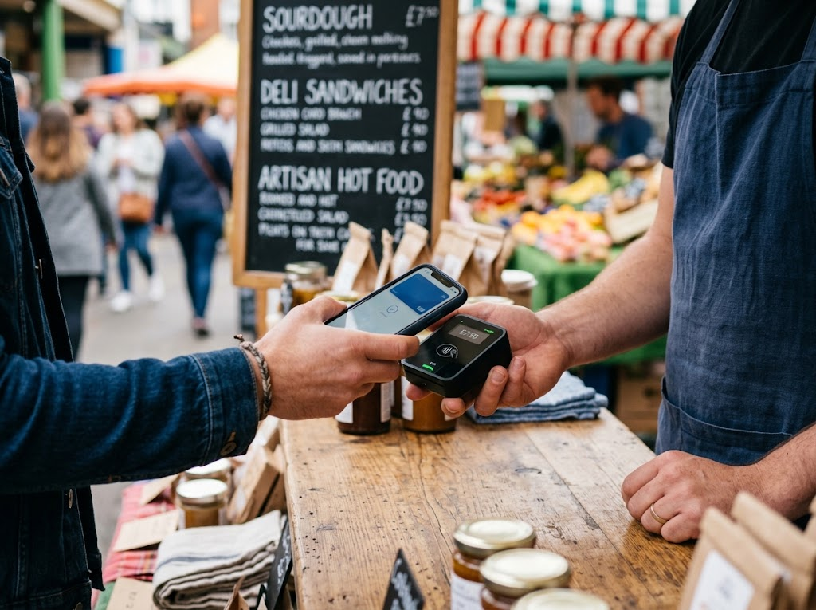
EDEXCEL GCSE BUSINESS · PAPER 1
Tap to Pay
A few years ago, taking card payments meant renting an expensive machine from a bank. Now a small card reader that links to a phone costs little to buy, so even a market stall or a food van can accept cards and phone payments - and stop losing customers who carry no cash.
A cheap card reader lets even a market stall take card payments.
Understanding external influences on business
openrevise.com
Lesson 2 of 5

Slide 11
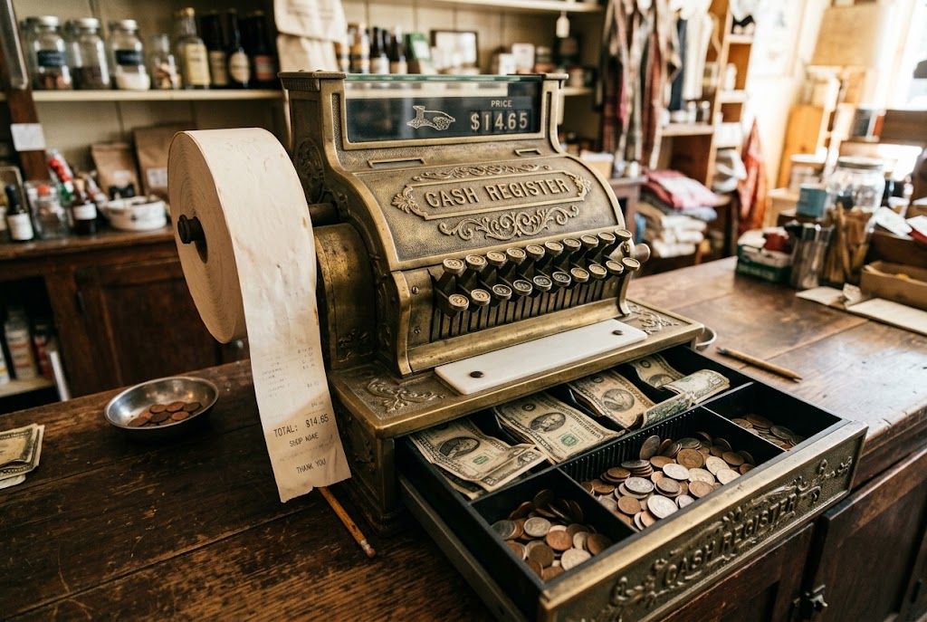
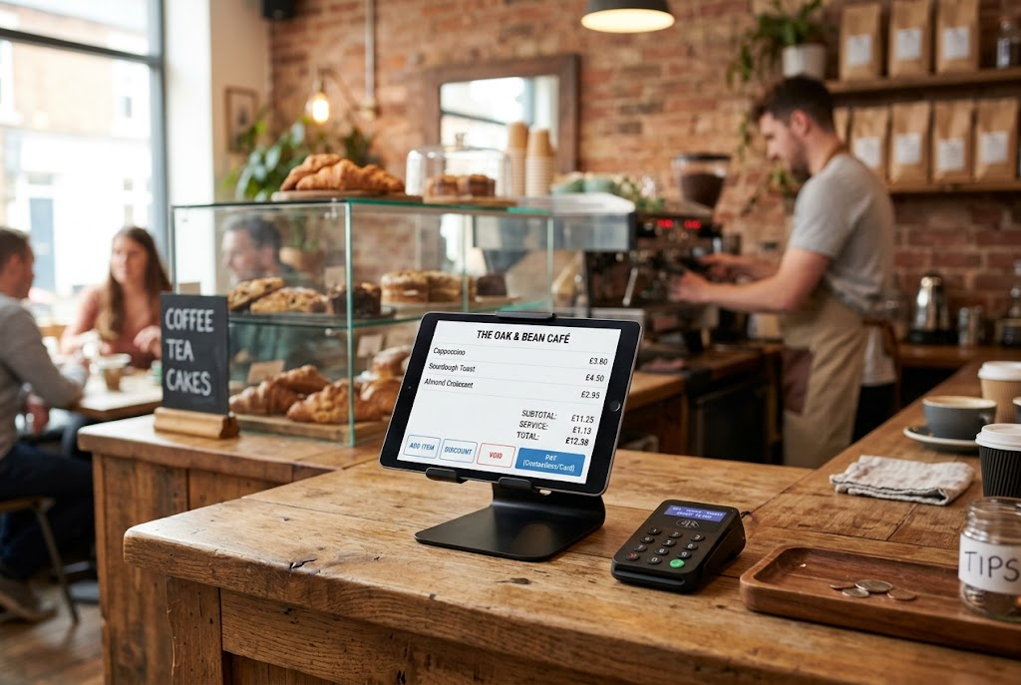
EDEXCEL GCSE BUSINESS · PAPER 1
Then and Now
The same small shop counter, ten years apart.
Then: cash only, sales counted by hand.
Now: card payments, with every sale recorded automatically.
Understanding external influences on business
openrevise.com
Lesson 2 of 5

Slide 12
EDEXCEL GCSE BUSINESS · PAPER 1
PART TWO
How Technology Influences Business
Sales, costs and the marketing mix.
openrevise.com

Slide 13

EDEXCEL GCSE BUSINESS · PAPER 1
The Impact on Sales
Technology can increase sales - but it also increases competition.
More customers
E-commerce reaches customers far beyond the local area.
More sales per customer
Easy payment and one-click ordering make buying quicker, so customers buy more.
Reviews
Good online reviews attract new customers; bad ones drive them away.
More competition
Customers can find and compare rivals online in seconds, so sales can be lost as easily as won.
Understanding external influences on business
openrevise.com
Lesson 2 of 5

Slide 14

EDEXCEL GCSE BUSINESS · PAPER 1
The Impact on Costs
Technology can cut some costs while adding others.
Lower costs
Selling online avoids high-street rent; social media promotion is cheap; digital records save staff time.
New costs
Buying equipment and software, building a website, fees on card payments and online marketplaces.
Training
Staff may need training to use new systems.
Keeping up
Technology changes quickly, so equipment and websites need updating.
Understanding external influences on business
openrevise.com
Lesson 2 of 5

Slide 15
EDEXCEL GCSE BUSINESS · PAPER 1
Technology and the Marketing Mix
The P
How technology changes it
Product
New products become possible, and online reviews make quality more visible
Price
Customers compare prices online, so prices must be competitive
Promotion
Social media and digital communication make promotion cheap and targeted
Place
E-commerce lets customers buy online, anywhere, at any time
Understanding external influences on business
openrevise.com
Lesson 2 of 5

Slide 16

EDEXCEL GCSE BUSINESS · PAPER 1
CASE STUDY
Contactless: A Payment Revolution
Contactless card payments began in the UK in 2007, with a limit of £10 per payment. As customers came to trust it, the limit rose - to £20, then £30, then £45 in 2020 - and in October 2021 it reached £100. For small businesses, cheap mobile card readers mean that a market stall, a food van or a window cleaner can now take contactless payments as easily as a supermarket. A business that still takes only cash risks losing the growing number of customers who rarely carry any.
2007
£100
Contactless payments launched in the UK at £10
The contactless limit since October 2021
Understanding external influences on business
openrevise.com
Lesson 2 of 5

Slide 17

EDEXCEL GCSE BUSINESS · PAPER 1
Key Terms
E-commerce
Buying and selling goods and services online.
Social media
Websites and apps that let users share content and talk to each other.
Digital communication
Communicating electronically, e.g. by email, messaging, video calls and websites.
Payment system
A way for customers to pay, such as contactless cards, mobile phones or online payment services.
Online marketplace
A website where many businesses sell their products, usually paying a fee on each sale.
Understanding external influences on business
openrevise.com
Lesson 2 of 5

Slide 18

EDEXCEL GCSE BUSINESS · PAPER 1
YOUR TASK
12 minutes
Bring the Business Up to Date
A family-run fish and chip shop takes orders only over the counter, accepts only cash, and promotes itself with a sign in the window. Recommend three technologies it should use. For each, explain the likely effect on its sales and on its costs.
1
Choose three technologies.
2
Explain the effect on sales.
3
Explain the effect on costs.
WHAT A GOOD ANSWER SHOWS
Three technologies from the four types, each with a specific effect on sales and a specific cost, such as card fees or delivery-app commission.
Understanding external influences on business
openrevise.com
Lesson 2 of 5

Slide 19

EDEXCEL GCSE BUSINESS · PAPER 1
Can I...?
Explain e-commerce.
Explain how small businesses use social media.
Explain digital communication.
Explain modern payment systems.
Explain how technology affects sales.
Explain how technology affects costs.
Explain how technology affects the marketing mix.
Understanding external influences on business
openrevise.com
Lesson 2 of 5

Slide 20
EDEXCEL GCSE BUSINESS · PAPER 1
Summary & Exam Focus
Four types of technology: e-commerce, social media, digital communication and payment systems.
Technology can increase sales, but makes competition fiercer.
It cuts some costs and adds others.
It has changed every element of the marketing mix.
EXAM FOCUS
Explain one way that new payment systems could increase the sales of a small business. (3 marks)
Name the technology, then take the chain all the way to sales, costs or profit. "Customers can pay by card" is only the first step.
openrevise.com

