Slide 1

EDEXCEL GCSE BUSINESS · PAPER 1
Legislation and business
Understanding external influences on business
Lesson 3 of 5
openrevise.com

Slide 2

EDEXCEL GCSE BUSINESS · PAPER 1
Last Lesson
Answer from memory before the answers appear.
Name the four types of technology used by businesses.
1
Give one way technology can cut costs.
2
Give one new cost technology creates.
3
How has technology changed price in the marketing mix?
4
Understanding external influences on business
openrevise.com
Lesson 3 of 5

Slide 3
EDEXCEL GCSE BUSINESS · PAPER 1
Last Lesson - Answers
Name the four types of technology used by businesses.
E-commerce, social media, digital communication and payment systems.
1
Give one way technology can cut costs.
Selling online avoids rent, social media promotion is cheap, digital records save time.
2
Give one new cost technology creates.
Equipment, software, websites, card fees or marketplace fees.
3
How has technology changed price in the marketing mix?
Customers compare prices online, so prices must be competitive.
4
Understanding external influences on business
openrevise.com
Lesson 3 of 5

Slide 4

EDEXCEL GCSE BUSINESS · PAPER 1
Learning Objectives
Explain the purpose of legislation.
1
Explain the principles of consumer law: quality and consumer rights.
2
Explain the principles of employment law: recruitment, pay, discrimination and health and safety.
3
Explain the impact of legislation on a business: the cost of meeting the law, and the consequences of breaking it.
4
Understanding external influences on business
openrevise.com
Lesson 3 of 5

Slide 5

EDEXCEL GCSE BUSINESS · PAPER 1
Why Do We Have Business Laws?
Legislation means laws passed by Parliament. Business laws exist to protect people.
Protect customers
So they get what they pay for, and are treated fairly if something goes wrong.
Protect employees
So they are paid fairly, treated equally and kept safe at work.
Fair competition
So every business plays by the same rules.
Applies to every business
A one-person market stall must follow consumer law, and any business that employs staff must follow employment law.
Understanding external influences on business
openrevise.com
Lesson 3 of 5

Slide 6

EDEXCEL GCSE BUSINESS · PAPER 1
PART ONE
Consumer Law
Protecting the people who buy.
openrevise.com

Slide 7

EDEXCEL GCSE BUSINESS · PAPER 1
Quality: What Customers Are Entitled To
Under the Consumer Rights Act 2015, goods sold to customers must be:
Of satisfactory quality
Not faulty or damaged, and as good as a reasonable person would expect for the price.
Fit for purpose
Able to do what they are meant to do - and anything the seller said they could do.
As described
Matching the description on the packaging, in the advert, on the website or given by the seller.
Services
Must be carried out with reasonable care and skill, at a reasonable price and within a reasonable time, if none was agreed.
Understanding external influences on business
openrevise.com
Lesson 3 of 5

Slide 8

EDEXCEL GCSE BUSINESS · PAPER 1
Consumer Rights: When Something Goes Wrong
If goods are faulty, customers have the right to put it right.
A refund
Within 30 days of buying faulty goods, customers can reject them and get a full refund.
A repair or replacement
After 30 days, the business must first be given a chance to repair or replace the goods.
A later refund or price cut
If the repair or replacement fails, the customer can then ask for a refund or a reduction in price.
Not for a change of mind
These rights are for faulty goods. Many shops choose to allow returns of unwanted goods, but in a shop it is not required by law.
Understanding external influences on business
openrevise.com
Lesson 3 of 5

Slide 9

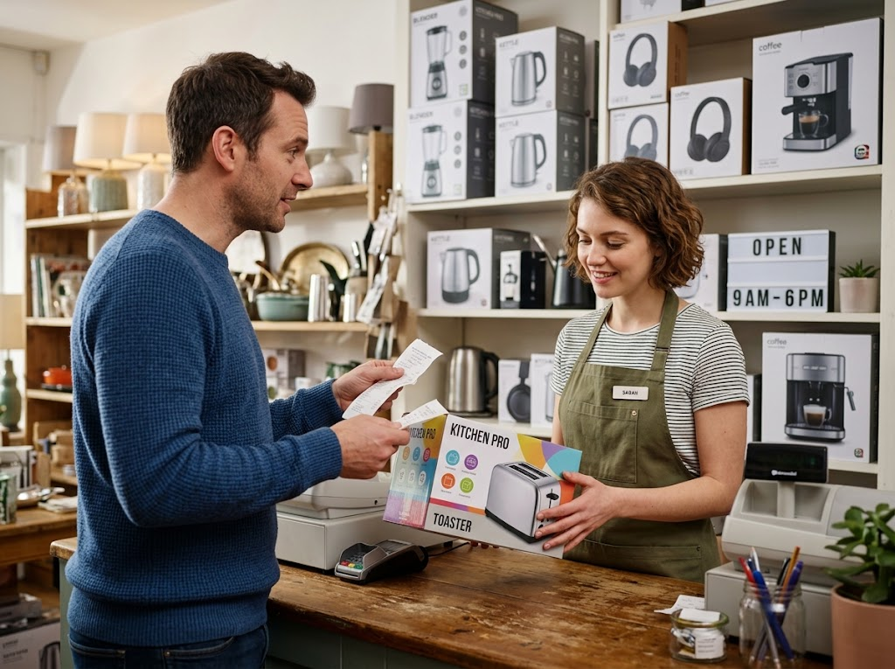
EDEXCEL GCSE BUSINESS · PAPER 1
Consumer Rights at the Counter
If a customer returns a faulty kettle two weeks after buying it, the law is on their side: they are entitled to a full refund. A small business that refuses risks a complaint, bad reviews and, in the end, a court claim - so it pays to know the rules.
Faulty goods returned within 30 days must be refunded.
Understanding external influences on business
openrevise.com
Lesson 3 of 5

Slide 10
EDEXCEL GCSE BUSINESS · PAPER 1
PART TWO
Employment Law
Protecting the people who work.
openrevise.com

Slide 11
EDEXCEL GCSE BUSINESS · PAPER 1
The Principles of Employment Law
Recruitment
Businesses must recruit fairly: job adverts and interviews cannot discriminate, and they must check that new staff have the right to work in the UK.
Pay
Employees must be paid at least the National Minimum Wage or National Living Wage for their age, set by the government and usually raised every April.
Discrimination
The Equality Act 2010 makes it illegal to treat people unfairly because of protected characteristics such as age, disability, race, religion, sex or sexual orientation.
Health and safety
The Health and Safety at Work Act 1974 requires employers to keep staff, customers and visitors safe - with training, safe equipment and risk assessments.
Understanding external influences on business
openrevise.com
Lesson 3 of 5

Slide 12

EDEXCEL GCSE BUSINESS · PAPER 1
Pay and Discrimination
Treating staff fairly is a legal duty, not a choice.
Minimum wage
Every worker must be paid at least the legal minimum for their age. A business cannot pay less, however small it is.
Equal pay
Men and women doing the same or equivalent work must be paid the same.
In recruitment
A small business cannot refuse to hire someone because of their age, race, religion, disability or any other protected characteristic.
At work
The same rules cover promotion, training and dismissal.
Understanding external influences on business
openrevise.com
Lesson 3 of 5

Slide 13

EDEXCEL GCSE BUSINESS · PAPER 1
Health and Safety
Every business must keep people safe.
Risk assessments
Identifying hazards - a hot oven, a wet floor, heavy boxes - and reducing the risk.
Training and equipment
Showing staff how to work safely and providing protective equipment such as gloves or goggles.
Safe premises
Fire exits, first aid, safe wiring and clear walkways.
Food businesses
Must also meet food hygiene rules, and are inspected and given a food hygiene rating by the local council.
Understanding external influences on business
openrevise.com
Lesson 3 of 5

Slide 14
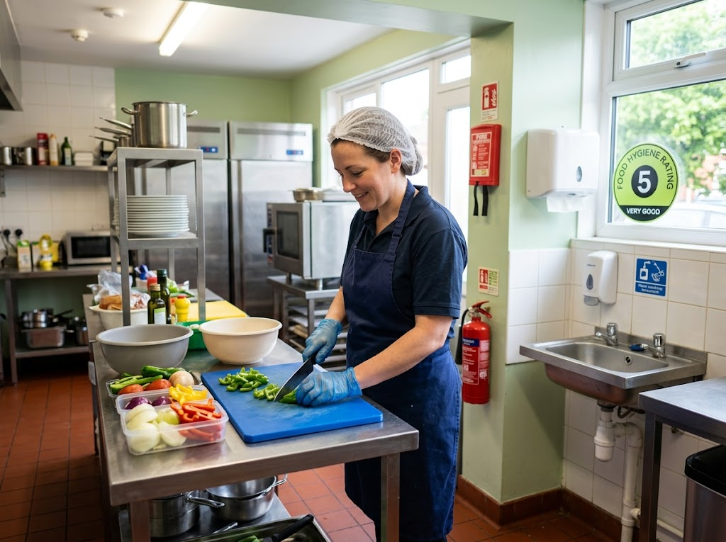
EDEXCEL GCSE BUSINESS · PAPER 1
Safety in a Small Kitchen
HEALTH AND SAFETY IN A CAFÉ KITCHEN
Training
Staff know how to use knives, ovens and fryers safely.
Equipment
Gloves, hairnets and colour-coded boards.
Premises
Fire extinguishers, first aid and hand-washing sinks.
Training, equipment and safe premises: health and safety law in practice.
Understanding external influences on business
openrevise.com
Lesson 3 of 5

Slide 15
EDEXCEL GCSE BUSINESS · PAPER 1
PART THREE
The Impact of Legislation
It costs money to obey the law - and much more to break it.
openrevise.com

Slide 16

EDEXCEL GCSE BUSINESS · PAPER 1
Meeting the Law, or Breaking It
THE COST OF MEETING THE LAW
THE CONSEQUENCES OF BREAKING IT
• Paying at least the minimum wage raises wage costs.
• Health and safety equipment, training and checks cost money.
• Refunds, repairs and replacements for faulty goods.
• Time spent learning the rules and keeping records.
• But: happier staff, loyal customers and a good reputation.
• Fines and compensation, which can be large for a small business.
• Having to repay underpaid wages.
• Being taken to an employment tribunal or to court.
• Bad publicity that drives customers away.
• In serious cases, being closed down or prosecuted.
Understanding external influences on business
openrevise.com
Lesson 3 of 5

Slide 17

EDEXCEL GCSE BUSINESS · PAPER 1
CASE STUDY
Named for Not Paying the Minimum Wage
The UK government regularly publishes lists naming employers who have underpaid their staff the National Minimum Wage. Employers on the list must pay back every penny they owe, and can be fined up to 200% of the amount they underpaid. Many of those named are small businesses - hairdressers, cafés, shops and care providers - some of which did not understand the rules. Being publicly named damages their reputation with both customers and future staff.
200%
Named
The maximum fine, as a share of the wages underpaid
Employers are listed publicly by the government
Understanding external influences on business
openrevise.com
Lesson 3 of 5

Slide 18

EDEXCEL GCSE BUSINESS · PAPER 1
Key Terms
Legislation
Laws passed by Parliament.
Consumer law
Laws that protect customers when they buy goods and services.
Satisfactory quality
Goods that are not faulty and are as good as a reasonable person would expect.
Fit for purpose
Able to do what the product is meant to do.
Employment law
Laws that protect employees at work.
National Minimum Wage
The lowest hourly pay an employer is legally allowed to pay a worker of a given age.
Understanding external influences on business
openrevise.com
Lesson 3 of 5

Slide 19
EDEXCEL GCSE BUSINESS · PAPER 1
Key Terms (cont.)
Discrimination
Treating someone unfairly because of a characteristic such as age, race, sex or disability.
Health and safety
Laws requiring employers to protect the safety of staff, customers and visitors.
Understanding external influences on business
openrevise.com
Lesson 3 of 5

Slide 20

EDEXCEL GCSE BUSINESS · PAPER 1
YOUR TASK
12 minutes
Spot the Law-Breaker
For each situation, decide whether the business has broken the law, which law, and what the business should have done: a shop refuses a refund on a phone charger that stopped working after a week; a café advertises for "young, energetic staff under 25"; a builder does not give staff hard hats; a salon pays its 22-year-old apprentice-trained stylist less than the minimum wage for their age.
1
Has the law been broken?
2
Which law?
3
What should the business have done?
WHAT A GOOD ANSWER SHOWS
Each situation linked to consumer law (quality and rights) or employment law (recruitment and discrimination, health and safety, pay), with the correct action.
Understanding external influences on business
openrevise.com
Lesson 3 of 5

Slide 21
EDEXCEL GCSE BUSINESS · PAPER 1
Can I...?
Explain the purpose of legislation.
Explain the law on discrimination.
Explain the rules on quality.
Explain health and safety law.
Explain customers' rights with faulty goods.
Explain the cost of meeting the law.
Explain the law on recruitment.
Explain the consequences of breaking it.
Explain the law on pay.
Understanding external influences on business
openrevise.com
Lesson 3 of 5

Slide 22
EDEXCEL GCSE BUSINESS · PAPER 1
Summary & Exam Focus
Legislation protects customers and employees and makes competition fair.
Consumer law: goods must be of satisfactory quality, fit for purpose and as described, with rights to refunds and repairs.
Employment law covers recruitment, pay, discrimination and health and safety.
Meeting the law costs money; breaking it brings fines, compensation and bad publicity.
EXAM FOCUS
Explain one impact on a small business of an increase in the National Minimum Wage. (3 marks)
For legislation questions, name the law, then explain the effect on costs, prices or profit - and, if relevant, what happens if the business ignores it.
openrevise.com

