Slide 1

EDEXCEL GCSE BUSINESS · PAPER 1
External influences
Understanding external influences on business
Lesson 5 of 5
openrevise.com

Slide 2

EDEXCEL GCSE BUSINESS · PAPER 1
Last Lesson
Answer from memory before the answers appear.
How does rising unemployment affect a business selling luxuries?
1
What does SPICED stand for?
2
How do higher interest rates affect a business with a loan?
3
What is VAT?
4
Understanding external influences on business
openrevise.com
Lesson 5 of 5

Slide 3
EDEXCEL GCSE BUSINESS · PAPER 1
Last Lesson - Answers
How does rising unemployment affect a business selling luxuries?
Customers have less income, so sales fall.
1
What does SPICED stand for?
Strong Pound, Imports Cheap, Exports Dear.
2
How do higher interest rates affect a business with a loan?
Repayments rise, increasing costs and reducing profit.
3
What is VAT?
A tax added to the price of most goods and services.
4
Understanding external influences on business
openrevise.com
Lesson 5 of 5

Slide 4

EDEXCEL GCSE BUSINESS · PAPER 1
Learning Objectives
Explain why external influences are important to a business.
1
Explain possible responses to changes in technology.
2
Explain possible responses to changes in legislation.
3
Explain possible responses to changes in the economic climate.
4
Understanding external influences on business
openrevise.com
Lesson 5 of 5

Slide 5

EDEXCEL GCSE BUSINESS · PAPER 1
Why External Influences Matter
External influences are factors outside a business that it cannot control but that affect how it operates.
Outside its control
A small business cannot stop a new law, a rise in interest rates or a new technology.
Opportunities
Some changes help - a new technology may cut costs, or a weaker pound may boost exports.
Threats
Others hurt - rising costs, new rules or customers with less to spend.
The key skill
Spotting changes early and responding well, so the business survives and even benefits.
Understanding external influences on business
openrevise.com
Lesson 5 of 5

Slide 6

EDEXCEL GCSE BUSINESS · PAPER 1
The Three External Influences
Technology
New ways to sell, promote, communicate and take payment - e-commerce, social media, digital communication and payment systems.
Legislation
New or changed laws on consumer rights, pay, discrimination, and health and safety.
The economic climate
Changes in unemployment, incomes, inflation, interest rates, taxes and exchange rates.
Understanding external influences on business
openrevise.com
Lesson 5 of 5

Slide 7

EDEXCEL GCSE BUSINESS · PAPER 1
PART ONE
Responding to Change
How a small business can react to each influence.
openrevise.com

Slide 8

EDEXCEL GCSE BUSINESS · PAPER 1
Responding to Changes in Technology
Adapt, or be left behind by competitors who do.
Adopt it
Start selling online, take contactless payments or promote on social media.
Train staff
Make sure staff can use new systems to serve customers well.
Change the marketing mix
Sell through new channels, compete on price online, promote digitally.
Weigh the cost
New technology costs money, so a small business must judge whether the extra sales or savings are worth it.
Understanding external influences on business
openrevise.com
Lesson 5 of 5

Slide 9

EDEXCEL GCSE BUSINESS · PAPER 1
Responding to Changes in Legislation
Obeying the law is not optional, but how a business adapts is a choice.
Update practices
Change pay rates, refund policies, recruitment adverts or safety procedures.
Absorb or pass on costs
Accept lower profit, or raise prices to cover the extra cost - for example after a minimum wage rise.
Cut other costs
Find savings elsewhere, such as reducing waste or energy use.
Use it positively
Promote high standards, such as a five-star hygiene rating, to win customers.
Understanding external influences on business
openrevise.com
Lesson 5 of 5

Slide 10

EDEXCEL GCSE BUSINESS · PAPER 1
Responding to Changes in the Economic Climate
When the economy changes, the marketing mix and costs usually change with it.
Falling incomes or rising unemployment
Offer cheaper products, value deals or smaller portions, and target new customers.
Inflation
Raise prices carefully, find cheaper suppliers, cut waste and reduce costs.
Higher interest rates
Pay off loans, avoid new borrowing, and delay expensive plans.
Exchange rates
An importer might find a UK supplier when the pound is weak; an exporter might sell more abroad.
Understanding external influences on business
openrevise.com
Lesson 5 of 5

Slide 11
EDEXCEL GCSE BUSINESS · PAPER 1
Change and Response
External change
Threat or opportunity?
Possible response
A rival starts selling online
Threat
Build a website or use an online marketplace
The minimum wage rises
Threat
Raise prices slightly or cut costs elsewhere
Inflation raises ingredient costs
Threat
Find cheaper suppliers or reduce portion sizes
Interest rates fall
Opportunity
Borrow to invest in new equipment
The pound weakens
Opportunity for an exporter
Promote more to overseas customers online
Unemployment rises
Threat for luxuries
Offer value deals and cheaper options
Understanding external influences on business
openrevise.com
Lesson 5 of 5

Slide 12

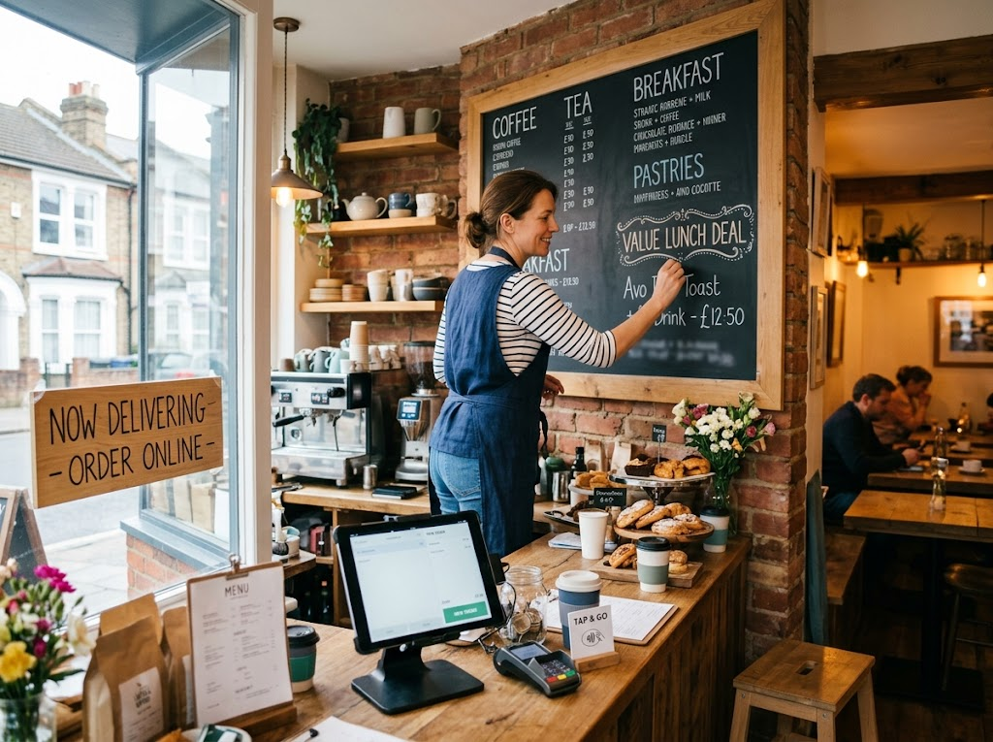
EDEXCEL GCSE BUSINESS · PAPER 1
Adapting to Survive
This café is responding to several external influences at once. A value lunch deal answers customers who have less to spend; online ordering and contactless payments answer changing technology. None of the changes were the owner's choice - but the response was.
Value deals for the economy, online ordering for technology: responding to change.
Understanding external influences on business
openrevise.com
Lesson 5 of 5

Slide 13

EDEXCEL GCSE BUSINESS · PAPER 1
CASE STUDY
2020: Every Influence at Once
In March 2020 the COVID-19 pandemic brought sudden changes from every direction. New laws forced cafés, restaurants and pubs to close their doors to customers. Many small food businesses responded with technology, switching to takeaway, delivery apps and online ordering almost overnight. The government responded to the economic damage with support such as the furlough scheme, which paid most of the wages of staff who could not work, and in August 2020 "Eat Out to Help Out", which paid half the cost of meals out from Monday to Wednesday, up to £10 per person. The businesses that survived were those that adapted fastest.
March 2020
August 2020
Lockdown laws close cafés and restaurants
Eat Out to Help Out: 50% off meals, up to £10 a head
Understanding external influences on business
openrevise.com
Lesson 5 of 5

Slide 14

EDEXCEL GCSE BUSINESS · PAPER 1
Key Terms
External influence
A factor outside a business that it cannot control but that affects it.
Economic climate
The state of the economy, including jobs, incomes and prices.
Opportunity
An external change that could help a business.
Threat
An external change that could harm a business.
Adapt
To change the way the business works in response to an external change.
Understanding external influences on business
openrevise.com
Lesson 5 of 5

Slide 15

EDEXCEL GCSE BUSINESS · PAPER 1
YOUR TASK
15 minutes
The Business Response Plan
You run a small independent bike shop that imports most of its bikes from Europe. In the same year, the pound weakens, the National Minimum Wage rises, and a large online retailer starts selling bikes more cheaply. For each change, say whether it is a threat or an opportunity, and plan one response.
1
Weak pound: threat or opportunity? Response?
2
Minimum wage rise: threat or opportunity? Response?
3
Online competitor: threat or opportunity? Response?
WHAT A GOOD ANSWER SHOWS
All three changes identified as threats, each with a realistic response - e.g. find UK suppliers, raise prices carefully or cut costs, and compete on repairs, expert advice and servicing that an online retailer cannot offer.
Understanding external influences on business
openrevise.com
Lesson 5 of 5
Notes:
The best answers use what a small shop can do that the online giant cannot - expert advice, servicing and repairs.

Slide 16

EDEXCEL GCSE BUSINESS · PAPER 1
Can I...?
Explain what an external influence is.
Explain why external influences matter to a business.
Explain responses to changes in technology.
Explain responses to changes in legislation.
Explain responses to changes in the economic climate.
Judge whether a change is a threat or an opportunity.
Understanding external influences on business
openrevise.com
Lesson 5 of 5

Slide 17
EDEXCEL GCSE BUSINESS · PAPER 1
Summary & Exam Focus
External influences are outside a business's control but affect everything it does.
The three influences are technology, legislation and the economic climate.
Changes can be threats or opportunities.
The business can choose how it responds - adapting quickly helps it survive.
EXAM FOCUS
Justify how a small business should respond to a rise in the cost of its raw materials. (9 marks)
For response questions, weigh up two options, explain the effect of each on sales, costs and profit, and make a clear, justified choice - "it depends on" how customers react.
openrevise.com

Slide 18
EDEXCEL GCSE BUSINESS · PAPER 1
Exam Practice: External Influences
Answer all questions. Use the context of the business in the question where one is given. · 25 minutes
Question 1 · 1 mark · Define
Define the term 'external influence'.
Question 2 · 1 mark · State
State one external influence on a business.
Question 3 · 2 marks · Outline
Outline one way a small business could respond to a rise in inflation.
Understanding external influences on business
openrevise.com
Lesson 5 of 5

Slide 19
EDEXCEL GCSE BUSINESS · PAPER 1
Exam Practice: External Influences (cont.)
Question 4 · 3 marks · Explain
Explain one way a small shop could respond to a competitor that starts selling online.
Question 5 · 9 marks · Justify
Justify which one of these two options Rosa should choose.
Understanding external influences on business
openrevise.com
Lesson 5 of 5

Slide 20
EDEXCEL GCSE BUSINESS · PAPER 1
Question 1 · 1 mark · Define
“
Define the term 'external influence'.
HOW TO ANSWER IT
Command word: Define. Worth 1 mark, so plan before writing.
Understanding external influences on business
openrevise.com
Lesson 5 of 5

Slide 21
EDEXCEL GCSE BUSINESS · PAPER 1
Question 1 · mark scheme
1 mark available. Award a mark for each point made.
A factor outside the business / beyond its control that affects it
1 mark
Understanding external influences on business
openrevise.com
Lesson 5 of 5

Slide 22
EDEXCEL GCSE BUSINESS · PAPER 1
Question 2 · 1 mark · State
“
State one external influence on a business.
HOW TO ANSWER IT
Command word: State. Worth 1 mark, so plan before writing.
Understanding external influences on business
openrevise.com
Lesson 5 of 5

Slide 23
EDEXCEL GCSE BUSINESS · PAPER 1
Question 2 · mark scheme
1 mark available. Award a mark for each point made.
Any one of: technology; legislation; the economic climate (or a named part of it, e.g. interest rates)
1 mark
Understanding external influences on business
openrevise.com
Lesson 5 of 5

Slide 24
EDEXCEL GCSE BUSINESS · PAPER 1
Question 3 · 2 marks · Outline
“
Outline one way a small business could respond to a rise in inflation.
HOW TO ANSWER IT
Command word: Outline. Worth 2 marks, so plan before writing.
Understanding external influences on business
openrevise.com
Lesson 5 of 5

Slide 25
EDEXCEL GCSE BUSINESS · PAPER 1
Question 3 · mark scheme
2 marks available. Award a mark for each point made.
A response identified, e.g. cheaper suppliers / raise prices / cut waste
1 mark
Developed: how it helps the business
1 mark
Understanding external influences on business
openrevise.com
Lesson 5 of 5

Slide 26
EDEXCEL GCSE BUSINESS · PAPER 1
Question 4 · 3 marks · Explain
“
Explain one way a small shop could respond to a competitor that starts selling online.
HOW TO ANSWER IT
Command word: Explain. Worth 3 marks, so plan before writing.
Understanding external influences on business
openrevise.com
Lesson 5 of 5

Slide 27
EDEXCEL GCSE BUSINESS · PAPER 1
Question 4 · mark scheme
3 marks available. Award a mark for each point made.
A response identified, e.g. sell online / improve service / compete on expertise
1 mark
First linked point of explanation
1 mark
Second linked point of explanation
1 mark
Understanding external influences on business
openrevise.com
Lesson 5 of 5

Slide 28
EDEXCEL GCSE BUSINESS · PAPER 1
Question 5 · 9 marks · Justify
“
Justify which one of these two options Rosa should choose.
— Rosa runs a small bakery. Inflation has increased the cost of her flour, butter and energy by 15% in a year, and her profit has fallen. Many of her customers are families on tight…
HOW TO ANSWER IT
Command word: Justify. Worth 9 marks, so plan before writing.
Understanding external influences on business
openrevise.com
Lesson 5 of 5

Slide 29
EDEXCEL GCSE BUSINESS · PAPER 1
Question 5 · mark scheme
9 marks available. Award a mark for each point made.
AO2 (Application, 3 marks): uses Rosa's context - 15% cost rise, falling profit, families on tight budgets, the two options
Level 1-3
AO3a (Analysis, 3 marks): chains of reasoning about each option
Level 1-3
AO3b (Evaluation, 3 marks): a justified choice with a supported judgement, e.g. "it depends on"
Level 1-3
Understanding external influences on business
openrevise.com
Lesson 5 of 5

